Slide 1
Ray Tracing the Real and the Unreal
Aashish Sheshadri
Ivan Oropeza
The University of Texas at Austin

Slide 2
Key Contributions
Adaptive Sampling
Texture Mapping
Bump Mapping
Depth of Field
Non-photo realistic illumination model
Edge rendering algorithm

Slide 3
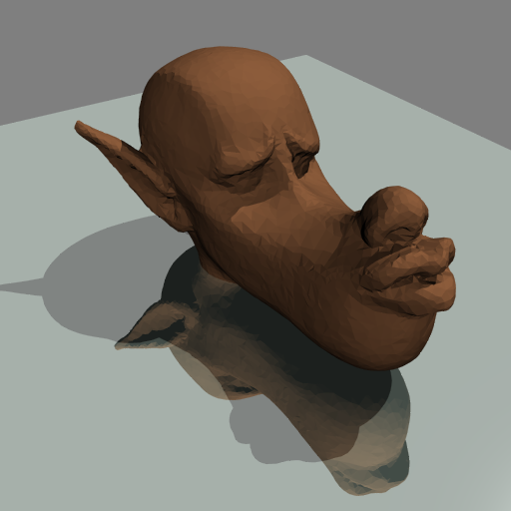
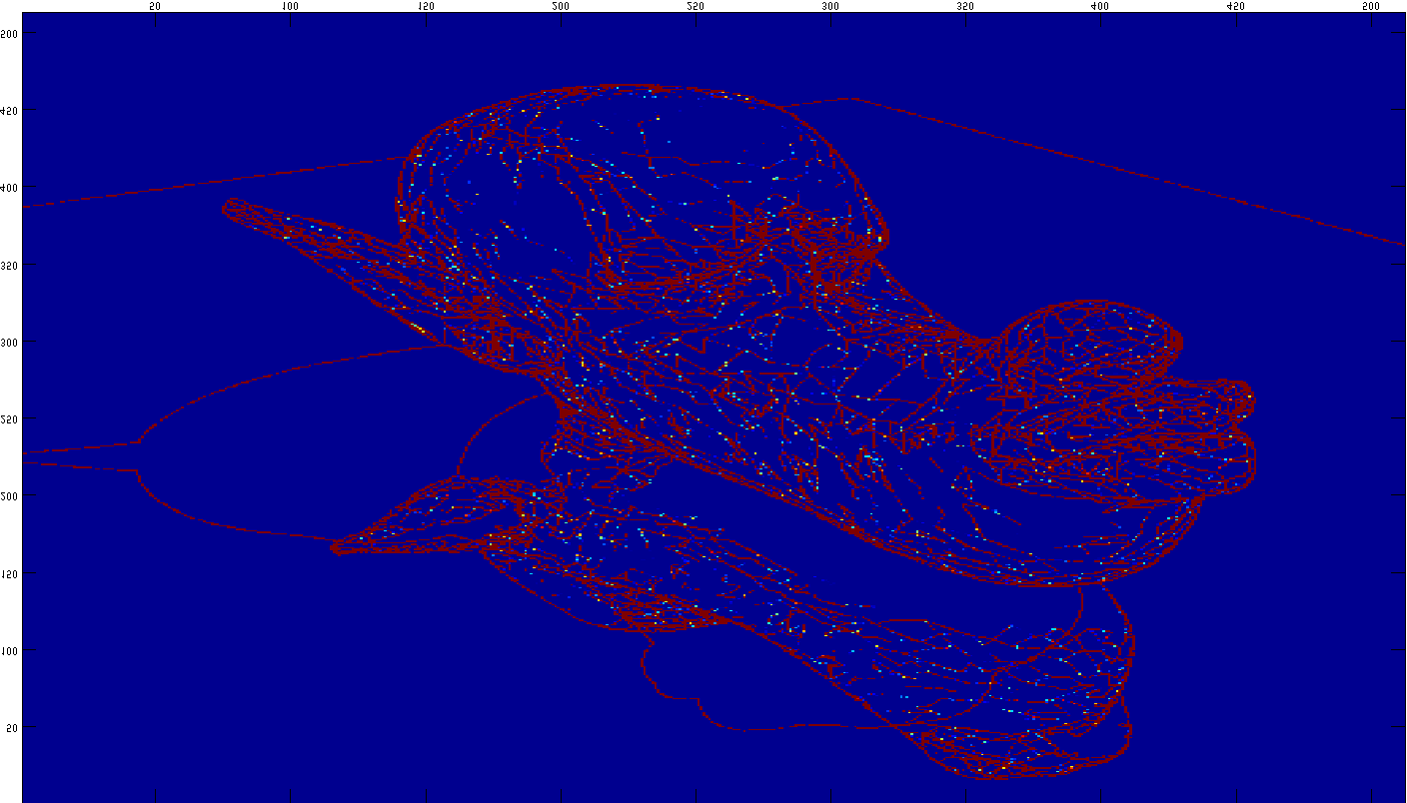
Adaptive Sampling

Slide 4
Texture and Bump Mapping

Slide 5
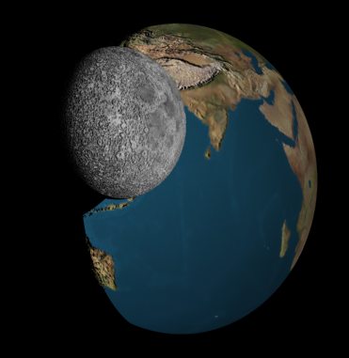


Slide 6
Depth of Field
Pinhole cameras are non existent!
Physical cameras have lenses to focus rays.
Consequently we have a circle of confusion with sharp focus at some distance d depending on the lens.

Slide 7
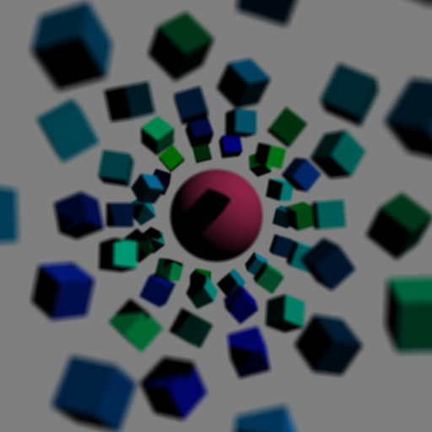
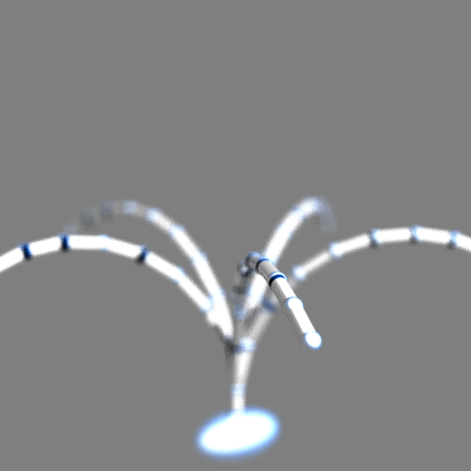

Slide 8
Non-Photo Realistic Illumination

Slide 9
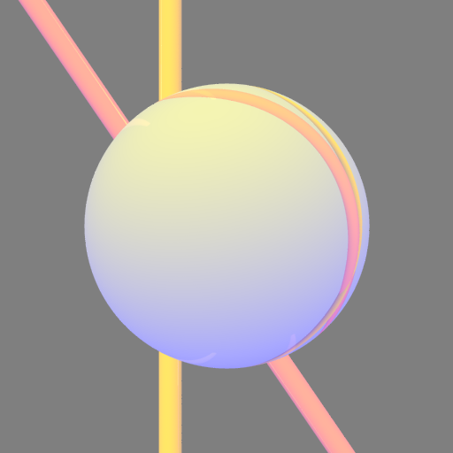
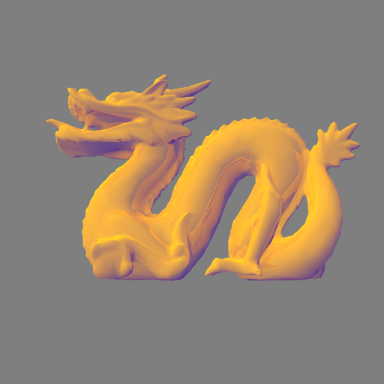

Slide 10
Rendering Edges
Why?
Edges provide viewers depth cues.
How?
Looking at depth discontinuities.
Looking at view angle discontinuities.
View angle approaches 90 degrees.

Slide 11
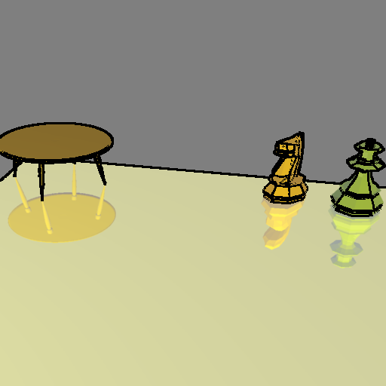


Slide 12
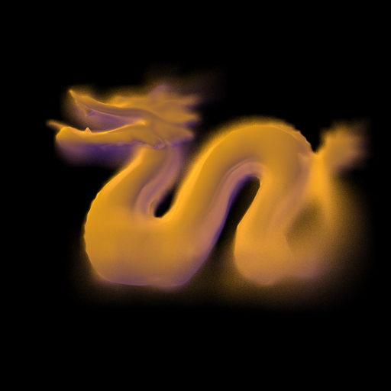
Transitioning..

Slide 13
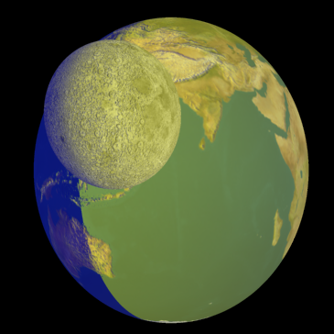
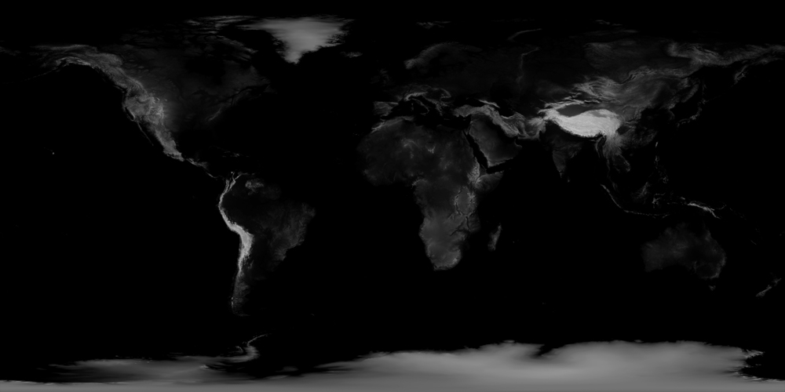
Bump and Texture Mapping with Non-Photo Realistic Illumination

Slide 14
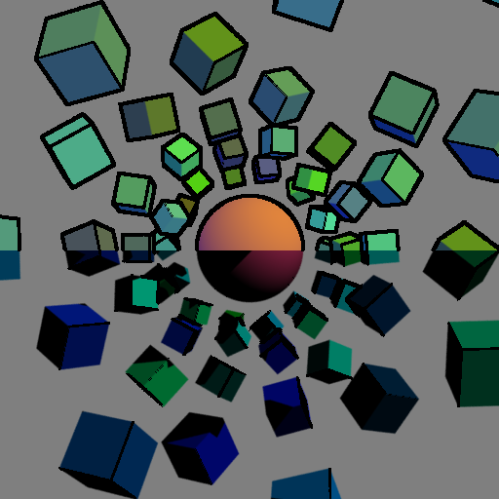
A Contrast

Slide 15
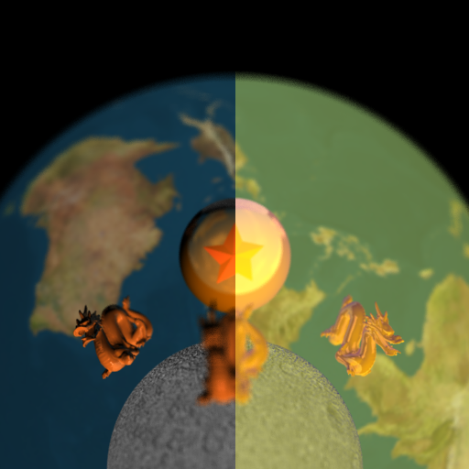
Eye Candy!

Slide 16
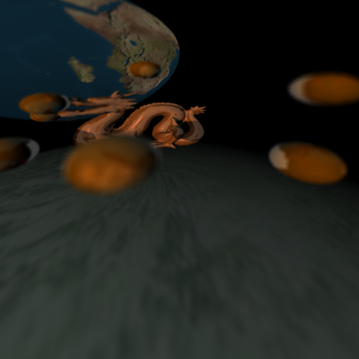
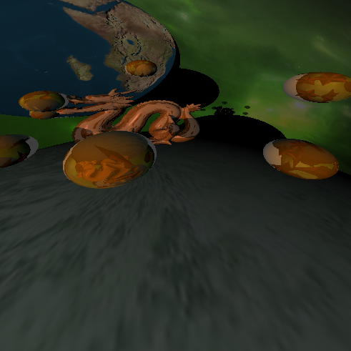
Thank you!

